Slide 1
Anesthesia Technology Program
Information Session

Slide 2
Agenda for Anesthesia Technology Information Session
Introduction
Program Requirements
Program Structure
Eligibility
Program Seats/Salary/Costs
Application Period
FAQ

Slide 3
What is an Anesthesia Technologist?
Work as a member of the anesthesia care team
Assist licensed anesthesia providers in acquiring, preparing, and applying anesthesia equipment and supplies
Prepare, maintain, and troubleshoot sophisticated medical equipment and supplies
Participate in line placement, airways, code events, and other procedures
Administer safe and efficient care to patients receiving anesthesia
Help transport and transfer patients
Operate mechanical, pneumatic, and electronic equipment for monitoring and managing anesthesia patients
Perform inspection, maintenance, and service record keeping (with appropriate training)
Provide support in pressure monitoring, autotransfusion, and laboratory functions
Demonstrate self-direction and supervision skills commensurate with training

Slide 4
Anesthesia Technology A.A.S
Introduction
The Tarrant County College Anesthesia Technology Program teaches students how to prepare for surgical procedures, to assist in the operating room and anywhere anesthesia is performed.
Career Opportunities
Administer safe & efficient care to patients receiving anesthesia
Prepare & maintain sophisticated medical equipment
Have choices in your work environment because anesthesia technologists work in a variety of clinical settings including:
  Hospitals
  Ambulatory surgery centers
  Outpatient facilities
Work in a health care profession with a bright job growth outlook

Slide 5
Anesthesia Technology A.A.S (continued)
Program Content
Studies combine general education and on-campus Anesthesia technology courses with actual clinical experience at clinical sites across the metroplex.
In addition, studies cover areas such as:
  Pathophysiology, Essentials of Medical Terminology, Professional Readiness, Wellness & Health Promotion
  Surgical Procedures, Fundamentals of Perioperative Concepts and Techniques
Accreditation
This Program is accredited by the Commission on Accreditation of Allied Health Programs (CAAHEP). CAAHEP Website
Certification
After completing the degree, the student is eligible to take the National Board Exam to become a Certified Anesthesia Technologist through the American Society of Anesthesia Technologist and Technicians (ASATT). ASATT Website

Slide 6
Pre-Requisite Courses
The following courses are required to apply for the program:
  BIOL 2401- Anatomy and Physiology I (Lecture & Lab)
  BIOL 2402- Anatomy and Physiology II (Lecture & Lab)
  CHEM 1406- Introductory Chemistry I (Lecture & Lab, Allied Health Emphasis)
  ENGL 1301- Composition I
  PSYC 2301- General Psychology

Slide 7
Other Requirements
Visual acuity (with corrective lenses if needed)
Adequate hearing (with auditory aid if needed)
Dexterity
Stand for prolong periods of time
Lift objects and transport equipment
Maneuver in limited spaces
Communicate effectively in verbal and written form
Adaptability to various environments
Computer and technology skills

Slide 8
Program Structure – 1st year
Fall term
  HPRS 1206- Essentials of Medical Terminology
  ANES 1371- Principles of Anesthesia Technology
  ANES 1372- Intro to Anesthesia Technology
  PHIL 2306- Introduction to Ethics
Spring term
  ANES 1370- Anesthesia (Basic) Pharmacology
  ANES 1373- Anesthesia Technology Fundamentals I
  ANES 1474- Anesthesia Technology Fundamentals II
Summer Term
  ANES 1375- Anesthesia Technology Clinic Experience I

Slide 9
Program Structure – 2nd year
Fall term
  ANES 2373- Anesthesia Technology Fundamentals II
  ANES 2474- Anesthesia Technology Instrumentation II
  ANES 2375- Anesthesia Technology Clinical Experience II
Spring term
  ANES 2476- Anesthesia Clinical Seminar & Review
  ANES 2475- Anesthesia Technician Clinical Experience III

Slide 10
Grade
Must earn a minimum of a “C” (75%) to pass
Any grade below 75% is considered a “F” and will require exit from the program

Slide 11
Eligibility
Must have a TCCD ID Number
To be eligible to apply for the Anesthesia Technology program, the student must first be a current TCCD student. This means that the student has a TCCD student ID number and has already applied and been accepted to the college.
Individuals that have not applied to the college may follow this link: Apply For Admission to begin the process.
Transcript Evaluation
ALL official transcripts from a college or university other than TCCD, must be received and evaluated by TCCD at the time of Application to the Anesthesia Technology AAS program.
First, submit your transcripts to the Transcript Office or your local Registrar's office.
This process can take up to two months, please keep this in mind.
TSI Requirements
Meet TCCD’s Texas Success Initiative (TSI) requirements. For additional information on TSI requirements, Please visit: TSI Requirements

Slide 12
Eligibility Continued
Prerequisite Science Courses
BIOL 2401- Anatomy and Physiology I (Lecture & Lab)*
BIOL 2402- Anatomy and Physiology II (Lecture & Lab)*
CHEM 1406- Introductory Chemistry I (Lecture & Lab, Allied Health Emphasis)
ENGL 1301- Composition I
PSYC 2301- General Psychology
Please note that you must have a C or higher for these grades to be considered.
Immunizations/Screenings
Please be aware that the TAC (Texas Administrative Code) and DFW Hospital Council Standards require that all students in health-related programs complete certain immunizations. These MUST be submitted with your application and completed prior to the beginning of the program, if accepted. They are currently as follows:
✓ HEPATITIS A & B
✓ MMR
✓ TDAP
✓ Varicella
✓ Influenza (during Fall Semester)
✓ TB Skin Test
✓ Covid-19 Vaccination (Hospital Requirement)
*Some of these immunizations take up to 6 months to complete (Hep A & B), it is best to get started NOW, or you can’t start the program.
Other Requirements
Once accepted into the program, you will be required to complete a drug screen, keep CPR current (American Heart Association certified BLS for Healthcare Providers), and a criminal background check. If you have any criminal charges, you need to email program leadership to discuss what you must do in order to find out whether or not you can apply for the program. Felony’s, Assault, Domestic Violence and Drug Charges automatically bar you from eligibility.
You will also need to renew your TB annually and Flu seasonally.
If there is something you feel might prevent you from being accepted into the program, it is your responsibility to contact the testing entity and the background check company prior to being accepted into the program. Should you learn that you will not pass the background check and/or the requirements for the national registry, you should not apply to any program within the health sciences.”
*You must have completed these courses within 5 years of your application and with a grade of “C” or higher. You are allowed only 2 attempts at earning your desired grade in these courses to be eligible to apply to the Anesthesia Technology program. A withdrawal or drop counts as an attempt.

Slide 13
Anesthesia Technology Program Seats and Average Salary Information
How many seats per application period?
  The Anesthesia Technology Program currently accepts up to 6 students per year; however, this can vary based on clinical availability. Those selected will begin classes in the following Fall semester. On average, the program has about 20 to 30 students apply in a single application period.
Salary Information
The starting base pay in the DFW metroplex for new graduates is between $20- $27/hour
  Each healthcare facility sets their own pay scale differently.
The median hourly wage, in Texas, for Anesthesia Technologists is $24/hr according to ZipRecruiters.com
WHERE CAN I LEARN MORE ABOUT THIS PROGRAM?
https://www.tccd.edu/anesthesiatech

Slide 14
Anesthesia Technology Program Costs
Program Cost: $5,084 Approximately
  Cost breakdown:
    In-District Tuition: $4,440
    Anesthesia Technology Scrub Patch: $5.48
    Scrubs: $40
    Textbooks: $599
  Estimate does not include additional expenses from all miscellaneous fees

Slide 15
Application Period
The Anesthesia Technology Program begins in August
Applicants are accepted based upon clinical availability
  Typically, 6 students are admitted annually
Time commitment:
  Full time schedule for 2 years (60 credit hours)
Schedule:
  Pending class times are Monday, Tuesday, and Thursday evenings from 5-8 pm
  Clinicals start in the summer term of the first year.
How to apply:
  Complete the online application at https://www.tccd.edu/admission/how-to-apply/ by June 1st
Selection Process
  GPA score
  Interview score
  Final selection
    Candidates will be ranked based on their combined GPA and interview scores
    Top-ranked candidates will be admitted back on available program slots

Slide 16



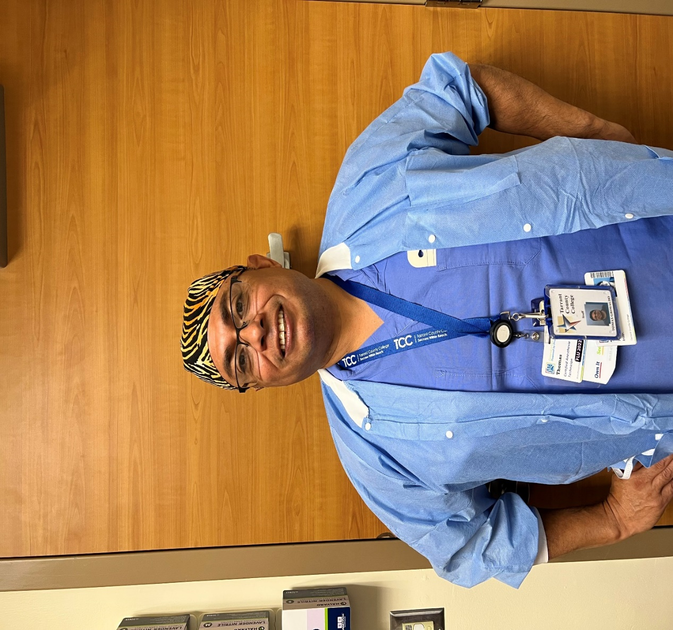
Anesthesia Technology Program Faculty
Jessica Sabers, CAA
Interim Program Director
Tanveer Khan, Cer.A.T.T.
Clinical Coordinator/
Faculty Instructor
Kelly Kirtek, CAA
Adjunct Instructor
Tomas Grimaldo, Cer.A.T.
Faculty Instructor
Kendyl McKeon, Cer.A.T.T.

Slide 17
Healthcare Professions
Advising Resource Hub
Do you have questions or want an advisor to look over your application?
Healthcare Professions Advising
817-515-1484
TR.HealthCareAdvising@tccd.edu
Advising by Appointment:
Fall & Spring Hours
  Monday-Friday: 8:00 am-5:00 pm
Summer Hours
  Monday-Thursday: 7:30 am-6:00 pm

Slide 18
Other Contacts
Jessica Sabers, CAA - Interim Program Director
Email: Jessica.Sabers@tccd.edu
Office: 817-515-2447
Tanveer Khan, Cer.A.T.T. – Faculty Instructor/Clinical Coordinator
Email: Tanveer.Khan@tccd.edu
Tomas Grimaldo, Cer.A.T. – Faculty Instructor
Email: Thomas.Grimaldo@tccd.edu

