Slide 1
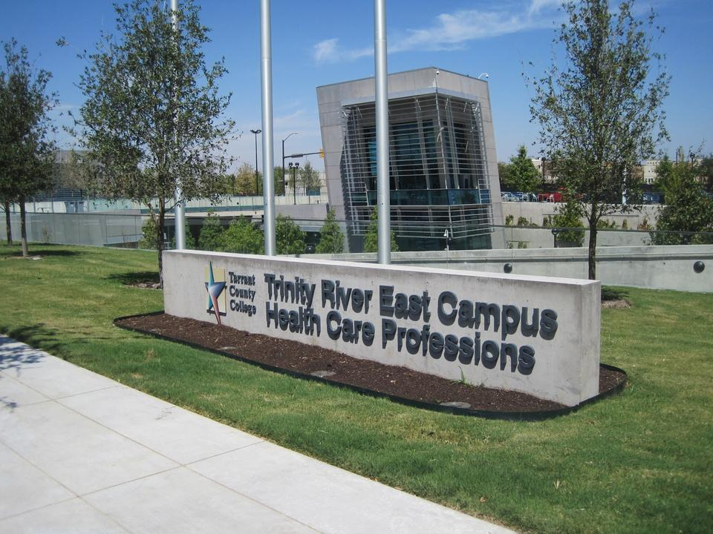
Central Sterile Processing
Tarrant County College Trinity River East Campus
Notes:
1

Slide 2
Agenda for Central Sterile Processing Information Session
What is a Sterile Processing Tech?
Stats
Prerequisites
Eligibility
Requirements
Length of Program & Schedule
Application Period/Seats/Costs
Contact information

Slide 3
What is a Sterile Processing Tech?
A Sterile Processing Technician, often abbreviated as SPD Tech or Sterile Tech, is a healthcare professional responsible for ensuring that medical instruments and equipment are properly cleaned, sterilized, and prepared for use in medical procedures. Their role is critical in maintaining a safe and sterile environment in healthcare facilities such as hospitals, clinics, and surgical centers.
Overall, Sterile Processing Technicians are essential members of the healthcare team who work behind the scenes to ensure the safety of patients and the success of medical procedures by maintaining the sterility of instruments and equipment. Their attention to detail and adherence to strict protocols help reduce the risk of infections and improve overall patients care outcomes.

Slide 4
What is the future-outlook for Sterile Processing Technicians?
According to the U.S. Bureau of Labor Statistics, medical equipment preparers, including sterile processing technicians, can expect a job growth of 6% from 2021 to 2031. This is as fast as the national average for all occupations
Average wage for a new tech is $19.94 an hour/$41,480 annually

Slide 5
Eligibility
Prerequisites
Be a TCC student and have a TCC student ID number
To be eligible to apply for the Central Sterile Processing program, the student must first be a current TCCD student. This means that the student has a TCCD student ID number and has already applied and been accepted to the college.
Have a diploma or GED
Be 18 years old
Have a current CPR Certification from The American Heart Association- Healthcare Provider
There are no prerequisites for the program

Slide 6
Eligibility Continued
Texas law and applicable health-care standards establish immunization requirements for students participating in health-related courses involving patient contact. Texas law also provides exemptions from certain immunization requirements for medical contraindications, reasons of conscience, including religious belief, and active-duty military service. Students seeking a statutory exemption must submit the documentation required by Texas law and Tarrant County College (TCC) student onboarding procedures.
Requesting a Statutory Exemption
Under Texas law and Texas Department of State Health Services (DSHS) (opens in a new tab) regulations, you may request an exemption from required immunizations for:
Reasons of conscience, including recognized religious beliefs
Medical contraindications (supported by licensed physician documentation)
Active-duty service in the U.S. military
Submitting an exemption request does not disqualify you from applying to or being considered for admission to a TCC Health Sciences program. Students seeking an exemption must submit required documentation following official TCC student onboarding procedures prior to established clinical placement deadlines.
Important Information Regarding Clinical Site Placement
While TCC honors statutory exemptions under Texas law, hands-on clinical education takes place at external hospitals, clinics, and partner health-care facilities:

Slide 7
Eligibility Continued
Clinical facility or other third-party clinical partner rules: External clinical affiliates establish and enforce their own independent health and safety requirements (including specific vaccination mandates such as Measles, Mumps, Rubella (MMR), Varicella (Chickenpox), Hepatitis A, Hepatitis B, Tetanus, Diphtheria & Pertussis (TDaP), flu, or COVID-19).
No College Guarantee: TCC cannot require an external partner facility to accept a student who has received an immunization exemption. The clinical facility makes the final determination regarding site access.
Impact on Program Completion: Successfully completing all mandatory clinical rotation hours and competencies is required to earn your degree or certificate. If a clinical partner declines an exemption and an alternate placement cannot be secured, you may face progression delays or be unable to complete the program

Slide 8
Requirements
Once accepted into the program, you will be required to complete a drug screen, keep CPR current (American Heart Association certified BLS for Healthcare providers), and a criminal background check. If you have any criminal charges, you need to email me to discuss what you must do in order to find out whether or not you can apply for the program. Felony’s, assault, Domestic Violence and Drug Charges automatically bar you from eligibility. You will also need to renew your TB annually and Flu seasonally.
House Bill 1508 which took effect in September 2017 requires that all o our students are notified that criminal offense convictions that occur while enrolled in our programs will affect their ability to apply for an occupational license.

Slide 9
Length of Program & Schedule
The program is two semesters long.
In the first semester, students take blended lecture and labs. This means they are both online and in person. Tentatively, class meets Tuesdays and Thursdays between 10:40 am and 2:10pm.
1st Semester
HPRS 1470 Central Sterile Processing 1
HPRS 1370 Central Sterile Processing 2
HPRS 1471 Central Sterile Processing 3
The second-semester students go to clinical. The clinical schedule is Monday and Wednesday from 7:00 am to 3:00 pm
2nd Semester
HPRS 1561 Clinical

Slide 10
Application Period
For Fall Admission:
Application Period: March 1st to April 1st
For Spring Admission:
Application Period: October 1st to November 1st

Slide 11
Seats
The Central Sterile Processing Program runs two cohorts a year. The number of applicants we accept each semester is based on clinical availability.

Slide 12
Cost
See Earn a Central Sterile Processing Certificate for costs.

Slide 13
Contact Information
Theresa Steele
Program Director
Email: Theresa.steele@tccd.edu
Shana Martin
Clinical Coordinator
Email: Shana.martin@tccd.edu
Health Care Professions
Advising Resource Hub
Kimberlyn Moore-Debrossard
Career Advisor
Call: 817-515-1484
Email: TR.HealthCareAdvising@tccd.edu

