Slide 1

SURGICAL TECHNOLOGY
INFORMATION SESSION

Slide 2
AGENDA FOR SURGICAL TECHNOLOGY INFORMATION SESSION
1. Introduction
2. Application Period/Seats/Costs
3. Admission Ranking
4. Selection Notification
5. Eligibility
6. Length of Program
7. FAQ

Slide 3
What is a Surgical Technologist?
The surgical technologist works under the supervision of a surgeon to ensure that the operating room or environment is safe, that equipment functions properly, and that the operative procedure is conducted under conditions that maximize patient safety. A surgical technologist possesses expertise in the theory and application of sterile and aseptic technique and combines the knowledge of human anatomy, surgical procedures, and implementation tools and technologies to facilitate a physician's performance of invasive therapeutic and diagnostic procedures.

Slide 4
SURGICAL TECHNOLOGY A.A.S
Introduction
The Tarrant County College Surgical Technology Program teaches students how to prepare for surgical procedures and to assist in the operating room.
Career Opportunities
Surgical Tech’s work in hospitals, outpatient centers, or for surgeons and spend most of their time on their feet in a fast-paced patient care environment.
The current employment pay rates can be viewed on our webpage under Job Titles & Career Info.
Program Content
Studies combine general education and on-campus surgical technology courses with actual clinical experience at clinical sites across the metroplex.
In addition, studies cover areas such as:
  Essentials of Medical Terminology, Professional Readiness, Wellness & Health Promotion
  Surgical Procedures & Fundamentals of Perioperative Concepts and Techniques
Accreditation
This Program is accredited by the Commission on Accreditation of Allied Health Programs (CAAHEP).
Certification
After completing the degree, the student is eligible to sit for the National Certification Exam for Surgical Technology through the National Board of Surgical Technologists and Surgical Assistants, which will award you Certification as a Surgical Technologist.

Slide 5
APPLICATION PERIOD
June 15th through October 1st
The Surgical Technology Program begins in January of each year
How to apply:
  Complete the online Surgical Technology Application
Do you have questions or want an advisor to look over your application?
HEALTH PROFESSIONS ADVISING
817-515-1484
TR.HealthCareAdvising@tccd.edu
*Please meet with an advisor before applying*

Slide 6
SURGICAL TECHNOLOGY PROGRAM SEATS, COSTS, AND AVERAGE SALARY INFO
How many seats per application period?
  The Surgical Technology Program currently accepts UP TO 30 students per year. Those selected will begin classes in the following Spring semester. On average, the program has about 50 to 100 students apply in a single application period.
Program Cost: $5,733 Approximately
  This includes uniforms, books, tuition and other miscellaneous costs.
Salary Information
The starting base pay in the DFW metroplex for new graduates was between $24- $30/hour
The median hourly wage, in Texas, for surgical technologists is reflected according to the Association of Surgical Technology's Average Hourly Pay Rate Map.
WHERE CAN I LEARN MORE ABOUT THIS PROGRAM?
  Surgical Technology webpage

Slide 7
ADMISSION RANKING
THE SELECTION COMMITTEE (NOT THE ADVISOR) CALCULATES AN ADMISSIONS RANKING FOR EACH STUDENT WHO COMPLETES AN APPLICATION. THE RANKING IS MADE UP OF YOUR SCIENCE PREREQUISITE COURSES GPA, HESI SCORES AND CUMULATIVE GPA.
HESI scores are ranked from all 5 subcategories – 75% or better
Grade Point Average
  Your undergraduate transcripts from regionally accredited colleges will be used to calculate a cumulative grade point average. Developmental classes do not count toward this calculation. If a student does not have at least 12 credit hours of college, high school transcripts will be used to calculate the GPA. If a student has taken a course more than once, the course with the highest grade will be used to calculate the GPA; thus a student may retake a course to increase their application ranking.
Prerequisite Courses
  BIOL 2401 Anatomy and Physiology 1 | Cannot be older than 5 years
  BIOL 2402 Anatomy and Physiology 2 | Cannot be older than 5 years
  BIOL 2420 or BIOL 2421 Microbiology

Slide 8
SELECTION NOTIFICATION:
CANDIDATES AND SELECTION INTO PROGRAM
When Will I Be Notified?
  1to 2 Weeks after the application deadline, the top 50 candidates are invited to a mandatory Top Applicants Meeting.
Selection Into Program
  Acceptance Notification of selected 30 applicants are sent within 48 hours after the Top Applicants Meeting.
Alternates
  The remaining applicants within the Top 50 (that attended the Top Applicants Meeting) are designated as alternates.
It is important to remember that selection is based on how each applicant compares with others in the applicant pool for this program.
Applicants with higher GPAs and science grades tend to be the most competitive.
The selection committee notifies all candidates by email of their admission status (accepted, alternate, not accepted, or incomplete). It is the applicant's responsibility to ensure that the correct email has been provided.

Slide 9
ELIGIBILITY
Must have a TCCD ID Number
To be eligible to apply for the Surgical Technology program, the student must first be a current TCCD student. This means that the student has a TCCD student ID number and has already applied and been accepted to the college.
Individuals that have not applied to the college may follow this link: Apply For Admission to begin the process.
Transcript Evaluation
ALL official transcripts from a college or university other than TCCD, must be received and evaluated by TCCD at the time of Application.
First, submit your transcripts to the Transcript Office or your local Registrar's office.
This process can take up to two months, please keep this in mind.
TSI Requirements
TSI met in all three areas
  Waivers not accepted
Meet TCCD’s Texas Success Initiative (TSI) requirements.
  For additional information on TSI requirements, Please visit: TSI Requirements

Slide 10
ELIGIBILITY CONTINUED
Prerequisite Courses
Please note that you must have a C or higher to be considered.
HPRS 1206 – Essentials of Medical Terminology
BIOL 2420 or 2421 - Microbiology for Non-Science or Science Majors
BIOL 2401 - A&P I*
BIOL 2402 - A&P II*
*Courses cannot be older than 5 years during admission process*
Please ALSO note that SCIT COURSES are not accepted replacements for the BIOL courses. We will not allow any exceptions.
Pre Admission Requirement
Please be aware that the TAC (Texas Administrative Code) and DFW Hospital Council Standards require that all students in health-related programs complete certain immunizations.
Hep B MUST be submitted with your application and completed prior to the beginning of the program, if accepted. Proof can be one of the following:
  Documentation of 3 dose series*
  Documentation of 2 dose series (Heplisav-B)
  Titers showing immunity
*Hep B 3 dose series can take up to 6 months to complete, it is best to get started NOW, or you cannot start the program.
Post Admission Requirements
MMR
TDAP
Varicella
Recent TB and Flu renewed annually while in the program
CPR BLS via AHA
Drug Screen and Background Check*
*If there is something you feel might prevent you from being accepted into the program, it is your responsibility to contact the testing entity and the background check company before being accepted into the program. Should you learn that you will not pass the background check and/or the requirements for the national registry, you should not apply to any program within the health sciences.

Slide 11
REQUIRED/RECOMMENDED COURSES
ALL SRGT AND OTHER COURSES (REQUIRED FOR DEGREE) MUST BE PASSED WITH A MINIMUM GRADE OF C
It is highly recommended that the following general education courses be completed prior to program application but not required.
  SPCH 1311 (Introduction to Speech Communication)
  PHIL 2306 (Intro to Ethics)
  ENGL 1301 (Composition 1)
  PSYC 2301 (General Psychology)
  HPRS 2201 (Pathophysiology)

Slide 12
SURGICAL TECHNOLOGY PROGRAM SCHEDULE/LENGTH
Course & Clinical Hours
Labs: Tues-Thurs from 8AM-3:30PM
Clinicals: Mon-Thurs from 6AM-2PM*
Lectures: Monday 1st year; Thursday 2nd year
This is a Full-Time Program
Students need to be able to commit to a full-time schedule for four semesters (18 months for A.A.S.) consecutively. Part-time or distance learning options are not available.
Students will receive an AAS in Surgical Technology upon completion.

Slide 13
PROGRAM TIMELINE (18-Months)
First Clinical Rotations
& Program Lectures
First Lab Session & General Ed. Courses
NEW: Advanced Techniques Lab
& Program Lectures
JAN
FEB
MAR
APR
MAY
JUN
JUL
AUG
SEP
OCT
NOV
DEC
Second Clinical Rotation
& Professional Readiness Courses
Certification Exam
JAN
FEB
MAR
APR
MAY
Graduation

Slide 14
SURGICAL TECHNOLOGY PROGRAM
DEGREE PLAN
Prerequisite Courses:
BIOL 2401: Human Anatomy & Physiology I
BIOL 2402: Human Anatomy & Physiology II
BIOL 2420: Microbiology for Non-sciences Majors
HPRS 1206: Medical Terminology
**All SRGT courses and HPRS 1202 must be taken in the semester listed and cannot be taken in advance or out of order.**
First Spring - Semester 1
SRGT 1366 Practicum
SPCH 1311 Intro to Speech Communication
SRGT 1405 Intro to Surgical Technology
SRGT 1409 Fundamentals of Perioperative Concepts
10-week Summer - Semester 2
SRGT 1266 Practicum
SRGT 1441 Surgical Procedures I
PHIL 2306 Intro to Ethics
PSYC 2301 General Psychology
First Fall – Semester 3
SRGT 1367 Practicum Surgical Technology
SRGT 1442 Surgical Procedures II
HPRS 2201 Pathophysiology
HPRS 1202 Wellness and Health Promotion
Second Spring - Semester 4
SRGT 2270 Professional Readiness
SRGT 2466 Practicum Surgical/Operating Room Tech
ENGL 1301 Composition 1

Slide 15
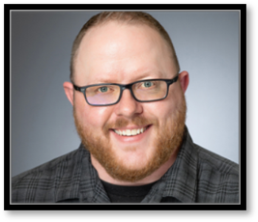
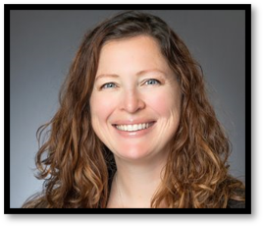

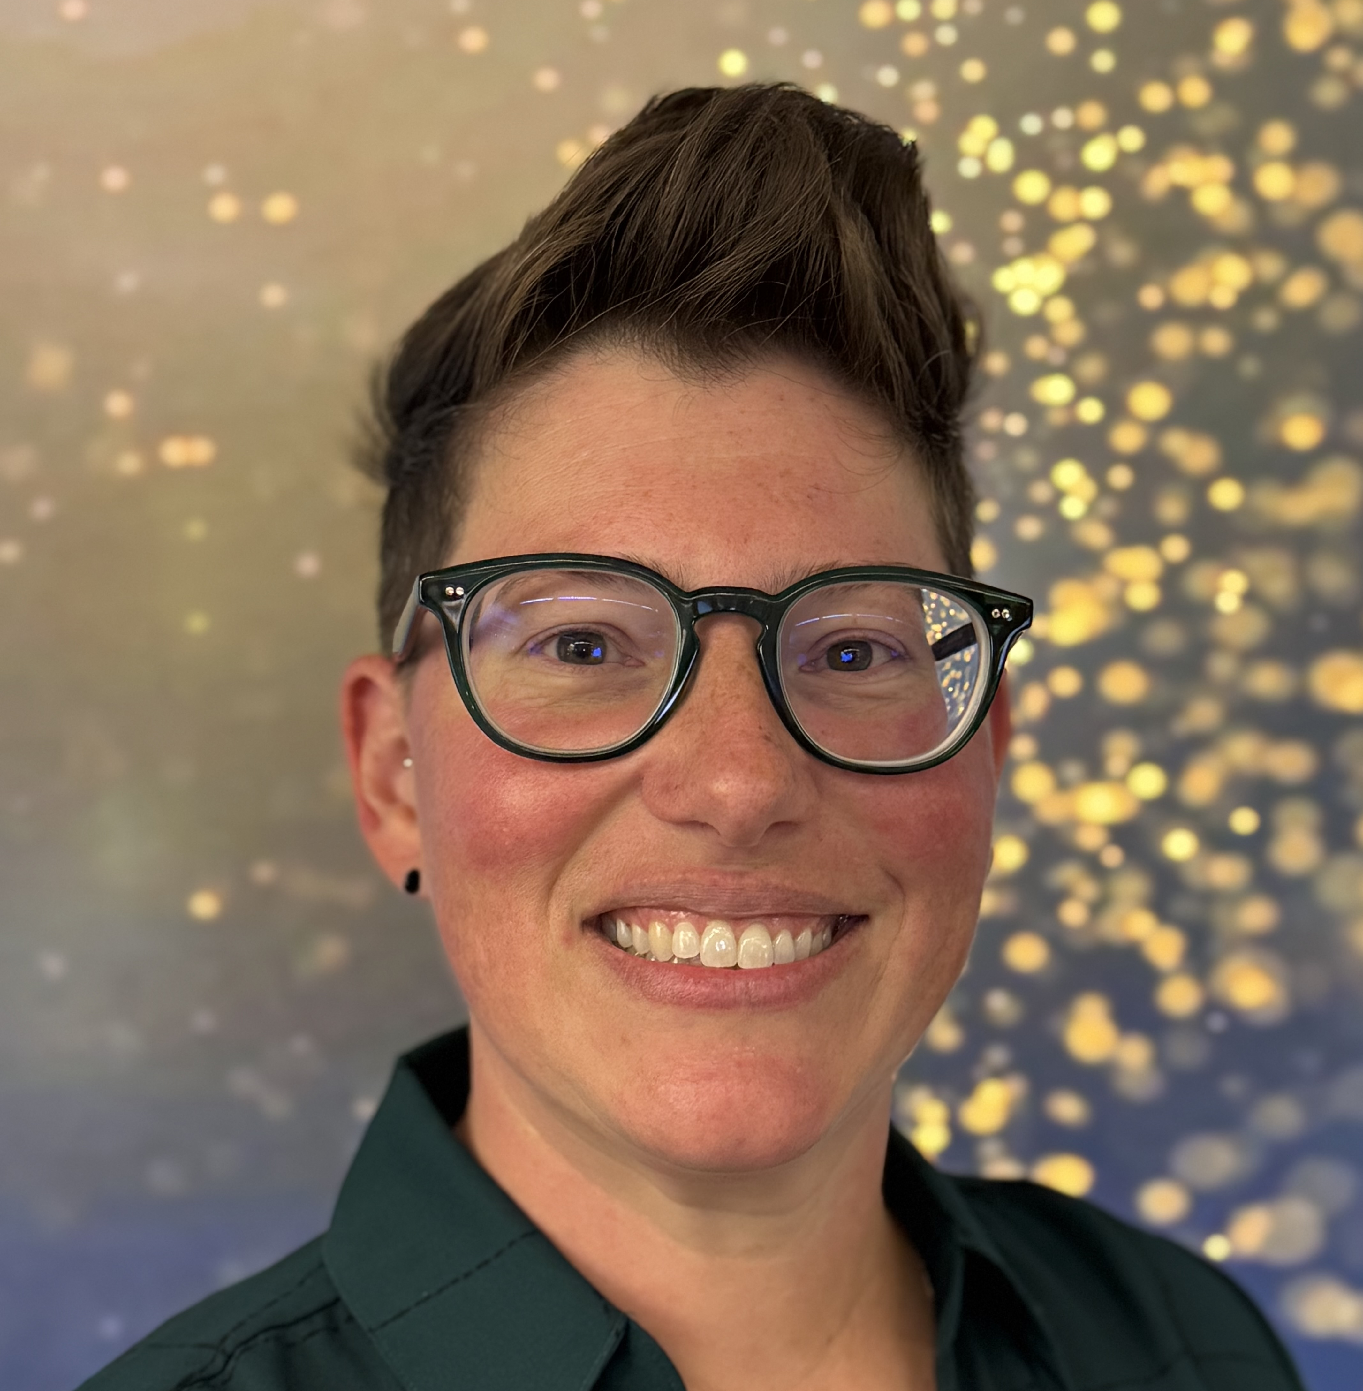
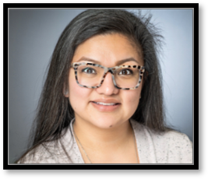
SURGICAL TECHNOLOGY PROGRAM FACULTY
Jeff Leonard
Program Director
Tiffany Stanton
Clinical Coordinator
Kymberly Dangerfield
Full-Time Faculty
Amanda Cermak
Full-Time Faculty
Iliana Carrasco
Full-Time Faculty

Slide 16
FAQ
If you have any questions over admissions, please contact:
Surgical Technology Admissions
at
TR.SurgicalTechnology@tccd.edu

