Slide 1

TCCD Internal Audit Plan 2025 - 2027
Presented by:
Tracey Shockley
Presentation Date:
August 14, 2025

Slide 2
Overview
The Audit Plan serves as a strategy document to help guide the internal audit function toward the fulfillment of the long-term objectives and aid in the success of the organization
The Internal Audit Department (“IAD”) has prepared a three-year rolling risk-based Internal Audit Plan for Fiscal Years 2025 – 2027. The Plan:
Includes a description of the planned internal audit activities that will be performed by IAD during the Fiscal Year.
Is a living document that can be modified at any point in time dependent upon any emerging risk, changes in control risk, and inherent risk.
Considers, on a risk-assessed basis the:
Reliability and integrity of financial and operational information
Compliance with policies, plans, procedures, laws, and regulations that could have a significant impact on operations
Safeguarding of assets
Effectiveness and efficiency of operations and programs relative to established goals and objectives and whether they are implemented and performing as intended
For Fiscal Year 2025 – 2026, the Internal Audit Department will be staffed with one Internal Audit Director, one staff position and co-sourcing.
The Audit Plan is prepared in reference to The Institute of Internal Auditors’ (“IIA”) Global Internal Audit Standards, notably Principle 9 Plan Strategically

Slide 3

Table of Contents
2025 – 2027 Internal Audit Planning and Approach | 4
Determination of Key Risks | 6
Summary of Identified Projects | 7
Appendix A – Audit Project Descriptions | 9
Year Two and Three Identified Projects | 13
Internal Audit Defined
Internal auditing is an independent, objective assurance and consulting activity designed to add value and improve an organization’s operations. It helps an organization accomplish its objectives by bringing a systematic, disciplined approach to evaluate and improve the effectiveness of risk management, control and governance processes.
Source: The Institute of Internal Auditors Professional Standards

Slide 4




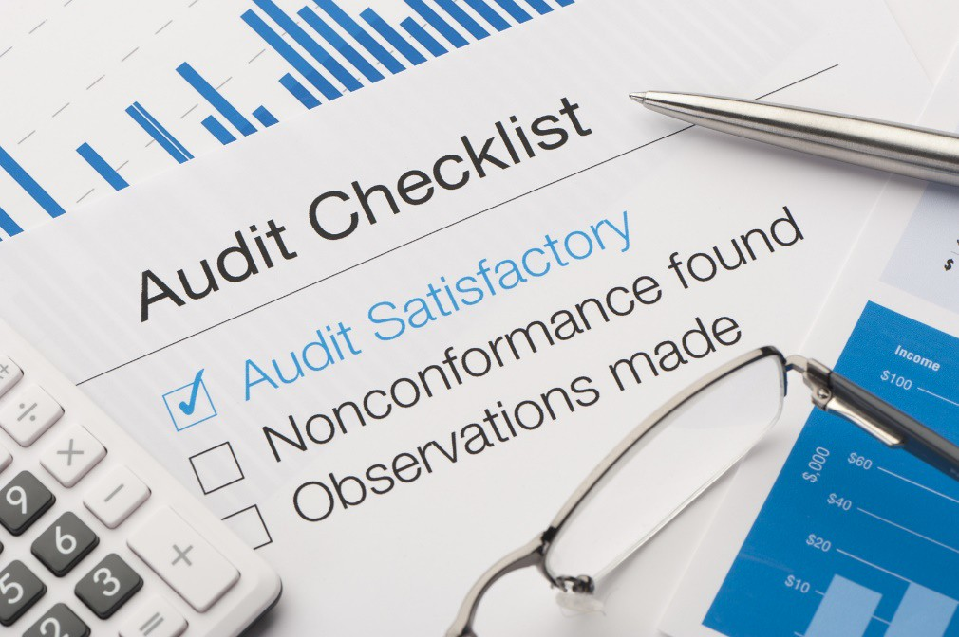
3-year Plan Approach
To create the 2025 - 2027 Internal Audit Plan, IAD:
Gathered information to understand the primary strategies, objectives, and risks for Tarrant County College District (TCCD).
Performed a risk assessment by interviewing members of Management in different college functions
Considered risk percentages for TCCD using the Internal Audit Universe Risk Model, auditable areas that have not been previously reviewed, and other applicable sources.
Considered managements’ input and areas that would not only impact the College operationally, but financially.
The Plan prioritizes the High-risk areas while also maintaining balance with Medium and Low risk areas across Plan years.
IAD will continue to conduct walkthroughs for each auditable area within the College.
IAD will update the planned projects and provide the updated planned projects to Management and to the Board throughout the year.

Slide 5




Cybersecurity Topical Requirements
In February 2025, the IIA released its Cybersecurity Topical Requirement (“Cyber TR”) to provide “a consistent, comprehensive approach to assessing the design and implementation of cybersecurity governance, risk management, and control processes…The requirements represent a minimum baseline for assessing cybersecurity in an organization.”
The guidance is mandatory for assurance services and recommended for advisory services. The goal of the guide is to align efforts and encourage collaboration between audit and InfoSec teams. The Cyber TR ensures that internal auditors approach cybersecurity audits with a consistent methodology.
The Cyber TR emphasizes the need for auditors to develop a thorough understanding of the cybersecurity landscape as week as understand and evaluate potential threats, vulnerabilities, and the implications of cyber incidents for organizational operations.
Unlike traditional audit approaches that often treat cybersecurity as an isolated risk, this requirement mandates that cybersecurity risks be integrated into audit plans continuously. This shift recognizes that cyber threats are dynamic, requiring an ongoing and adaptive audit approach.
The Topical Requirement highlights key considerations and requirements in the following areas:
Governance: formal strategy, policies and procedures, defined roles, and stakeholder engagement
Risk Management: cyber risk assessment, accountability, incident response and escalation, and awareness training
Controls: internal and vendor security, talent development, continuous monitoring, IT lifecycle security, and network/ endpoint protection

Slide 6
Key Risks
The list below reflects key areas identified through the risk assessment process that could impact the achievement of Tarrant County College Districts strategic objectives (Note: This is not intended to provide a complete set of risks). Please refer to the Audit Universe Manual for Risk Assessment.
TCCD Pervasive Risks – Auxiliary and Support Services | Line-Item Risk Possibilities
Construction Risk Maintenance Risk Custodial Risk Energy Management Risk Information Security Risk Registrar Risk Transportation Risk Inventory Management Risk Police Risk Technology/Public Relations Risk Curriculum Risk | Land Selection and Purchase Contractor Payment Regulatory Compliance Risk Fraud Risk Technology Risk Data Security Risk Disaster Recovery Risk Officer Training, Certification Student Records Bid Selection Application for grant funding – Title Funds
TCCD Pervasive Risks – Business and Financial Services | Line-Item Risk Possibilities
Payroll Risk Purchasing/Cash Disbursement Risk Purchasing/Bids & Contracts Risk Investments/Grants Risk Financial Reporting Risk Cash Management Risk Records Management HR Risk Accounts Payable Risk Workforce Education Risk | Tax Risk Grant Management Risk Faculty Contracts Risk Insurance Risk Data Access Risk Reimbursement Risk Disaster Recovery Risk ADA Monitoring for Funding Overtime pay

Slide 7
2025 – 2026 Project Summary
Based upon the risks identified, IA has classified the planned projects included in the following table. IA estimates it will perform them between September 2025 and August 2026, depending on the scope of projects selected. “Planned Projects” represent those projects that IA is planning to execute during 2025-2026. The planned projects identify the Enterprise Risk Management (ERM Risk) to the College and are tied to the 2030 Strategic Plan.
Detailed descriptions and risk assessments of the projects listed below are provided in Appendix A – Audit Project Descriptions.
Planned Projects 2030 Strategic Plan
 | Tarrant County College District - Administration
Faculty Workload/Pay | Full time, overload, compliance with TEC 51.402. Regulatory, Financial ERM Risk | Commitment to Excellence, Trust through Integrity
Student Fees | Regulations and policies practices. Regulatory, Financial ERM Risk | Commitment to Excellence, Connection to Belonging
Return of Title IV Funds | Compliance with Federal Regulation. Regulatory, Financial ERM Risk | Connection to Belonging, Trust through Integrity
 | Yearly Audits
Board of Trustees and Chancellor | Expenses and Travel and Reimbursement. Regulatory, Financial ERM Risk | Commitment to Excellence, Trust through Integrity
Campus Club Accounts | Campus Clubs compliance. Regulatory, Financial ERM Risk | Commitment to Excellence, Trust through Integrity
 | Campuses
Dual Credit | Compliance with policies, state laws and rules | Opportunities in Engagement, Transformation with Innovation

Slide 8
2025 – 2026 Project Summary (continue from page 7)
Planned Projects 2030 Strategic Plan
 | Auxiliary Support Services
Campus Security and Safety | Compliance with federal and state regulations, including the Clery Act | Commitment to Excellence, Connection to Belonging, Opportunity in Engagement
Fuel | Compliance with regulations, purchasing, storing and required licenses/certification | Commitment to Excellence, Connection to Belonging
 | Information Technology Systems
Administrative/Privileged Rights | Appropriateness and adequacy controls to risk exposure | Commitment to Excellence
Ransomware Risk Management | Controls to risk exposure and readiness to detect and respond to a ransomware event | Commitment to Excellence, Trust through Integrity
Penetration Testing | Vulnerabilities that could be exploited by an inside or outside threat of the College’s security perimeter | Commitment to Excellence, Trust through Integrity
Vulnerability Management & Scanning | Compliance TAC 202 Security Controls Catalog, control RA-5-Vulnerability Monitoring and Scanning | Commitment to Excellence, Trust through Integrity
Intrusion Prevention/Detection System | Logical and physical security and environmental protection controls are in place. | Commitment to Excellence, Trust through Integrity
 | Remediation Audits
SB - 17 | Compliance with Diversity, Equity and Inclusion requirements | Commitment to Excellence, Transformation with Innovation, Opportunity in Engagement

Slide 9
Appendix A – Audit Project Descriptions

Slide 10
2025 – 2026 Audit Plan Details (part 1 of 3)
Project | Project Description | Segment | Risk | Category
Faculty Workload/Pay (Co-Sourced) | To evaluate compliance with the Texas Education Code (TEC) 51.402 and applicable District requirements related to and monitoring faculty workload. A report is filed with the governing board by department, of the academic duties and services performed by each member of the faculty during the nine-month academic year. TCCD is compliant with Southern Association of Colleges and Schools Commission on Colleges (SACSCOC) Principle 6.2 b has employed a sufficient number of full-time faculty members to ensure curriculum and program quality, integrity, and review. Compliant with laws for allowable hours to teach, canceled classes, overload hours, and changes in all systems to ensure no overpayments. | College | High | Business and Finance Services
Student Fees (IA) | Perform an overall process and controls review of student fees, including approval, usage, balances, classification, and accounting practices. Ensure we are complying with Federal and State requirements, TEC Chapter 54 student fee expenditures and transfers are allowable and any other areas identified during the process review. | College | Med-High | Business and Finance Services
Return of Title IV Funds (IA) | To evaluate compliance with Federal Regulations related to the Return of Title IV Funds (R2T4). General rules that apply to the student financial assistance programs include Pell Grant, Federal Supplemental Educational Opportunity Grant (FSEOG), Federal Direct Loans, and any other areas identified during the process review. | Finance | High | Business and Finance Services
Board of Trustees and Chancellor Expenses (IA) | To assess the compliance, transparency, and efficiency of the processes governing the reimbursement of expenses, ensuring the funds are utilized in accordance with applicable policies, guidelines, and regulatory requirements. | Finance | Medium | Business and Finance Services

Slide 11
2025 – 2026 Audit Plan Details (part 2 of 3)
Project | Project Description | Segment | Risk | Category
Campus Club Accounts (IA) | An overall review of each TCCD campus student club accounts process and to assess the current policy and procedures that are in place. The purpose of such a review would be to ensure accountability and the clubs are managing finances according to established guidelines and policies. Meeting institutional requirements and maintaining their active status. Review any other areas identified during the process review. | College | Med-High | Business and Finance Services
Dual Credit (Co-Sourced) | To ensure TCCD is in compliance with applicable policies and procedures, and state laws and rules regarding matters such as student waivers, student eligibility, courses offered, and contract agreements, and any other areas identified during the process review. | Academics | Med-High | Operation and Support Services
Campus Security and Safety (IA) | Assessing adherence to federal and state regulations, including the Clery Act. Review policies and procedures, to include requirements for emergency notifications, timely warnings, sexual assault, stalking prevention and response. Evaluate the effectiveness and efficiency of campus safety operations. Review emergency management plans, evacuation procedures and communication systems. Review any other areas identified during the process review. | College | High | Operations and Support Services
Fuel (IA) | To evaluate compliance with regulations related to purchasing, storing, and required licenses/certifications for fuel. To ensure charges are appropriate, fuel access has the proper protocols in place and usage properly documented. Documented SOP's for propane, natural gas, regular, diesel, red dye, etc. and any other areas identified during the process review. | Facilities | Med-High | Operations and Support Services
Administrative and Privileged Rights (Co-Sourced) | Review the overall process and controls for Administrative and Privileged Rights and audit the users or groups with administrative rights, to include centralized and decentralized IT applications. To ensure appropriateness and adequacy of controls to risk exposure. Review any other areas identified during the process review. | Information Technology Systems | High | Operations and Support Services

Slide 12
2025 – 2026 Audit Plan Details (part 3 of 3)
Project | Project Description | Segment | Risk | Category
Ransomware Risk Management (Co-Sourced) | Assessment of relevant cybersecurity controls and test the College’s readiness to detect and respond to a ransomware event with tabletop exercises. Assess approximately 70 NIST CSF control subcategories relevant to ransomware and incident response preparedness. Review policies, procedures, and relevant documentation. Review any other areas identified during the process review. | Information Technology Systems | High | Operations and Support Services
Penetration Testing (Co-Sourced) | Identify possible vulnerabilities that could be exploited by an inside or outside threat of the College’s security perimeter. Testing can include both physical and technical security controls, and can include non-technical methods of attack. These types of testing can be conducted on hardware, software, or firmware components of an information system. | Information Technology Systems | High | Operations and Support Services
Vulnerability Management and Scanning (Co-Sourced) | To ensure SOP’s are documented and up-to-date. Ensure compliance with requirements of the TAC 202 Security Controls Catalog, control RA-5-Vulnerability Monitoring and Scanning, and evaluate if a vulnerability management process existed that would allow for timely detection and remediation of vulnerabilities within the District’s technology infrastructure. Review any other areas identified during the process review. | Information Technology Systems | High | Operations and Support Services
Intrusion prevention/detection system (Co-Sourced) | Assessment of relevant NIST cybersecurity controls. Ensure the controls have been properly implemented and operating effectively. Computer security incident response process is effective and efficient, the incident response staff are adequately trained, and the logical and physical security and environmental protection controls are in place to appropriately safeguard the College’s IDPS devices and the data within them. | Information Technology Systems | High | Operations and Support Services
SB – 17 (IA) | Ensure managements responses to corrective actions were implemented. Ensure TCCD continues to abide by and in compliance with SB-17. Review the Faculty Handbook, job descriptions and responsibilities across all departments within the College. Review the chart of accounts, job positions, organizational chart, services, departments, and activities. Review employees and new hires signed the SB-17 acknowledgment form. Ensure the college website and training resources are in compliance with SB-17 requirements. | District - Administration | Low-Medium | Operations and Support Services

Slide 13
2026 – 2028 Audit Plan Areas
Planned projects selected for years two and three of the three-year rolling 2025 - 2028 Internal Audit Plan. This schedule list audits that are planned for the following two years and is a living document. This allows for continuous risk assessments throughout the year and allowing for audits to be added or removed based upon current or emerging factors.
FY 2026 – 2027
Culture Audit Asset Management Accreditation International Students Services Required Regulatory Reporting Automotive Technology Vehicle Inventory Culinary, Hospitality | ITS – Backup and Recovery ITS – Wireless Network, Network and Network Reliability (proper configuration & controls) ITS – Application Software Security Board and Chancellor Expenses Campus Club Accounts Remediation Audits from 2025 – 2026
FY 2027 – 2028
Bookstore Contract Review Data Analytics Project Succession Planning Information Enrollment – growth, retention, contraction Hazelwood Exemptions Computer Science Contract Administration | ITS – IT Governance ITS – Infrastructure, Continuity & Recovery Planning ITS – Customer/Technical Support Board and Chancellor Expenses Campus Club Accounts Remediation Audits from 2026 – 2027

